Slide 1
UMANSIA
SMART PHONE HEART RATE MONITOR
Emre GÖKREM Tuğrul YATAĞAN Muhammet Fatih İNANÇ

Slide 2
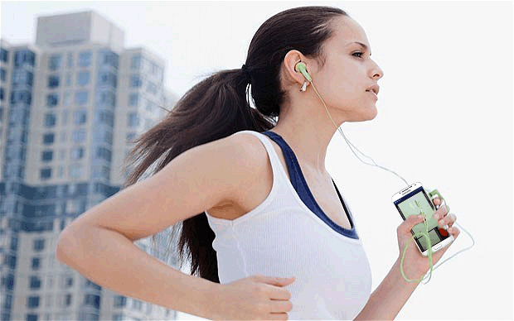

AIM
Measure heart rate
Track burning calories
Track sportive activities

Slide 3
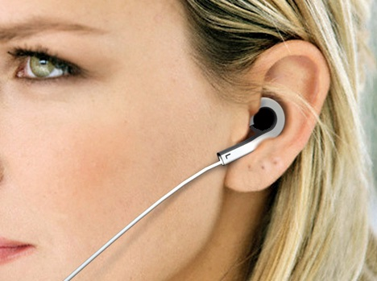
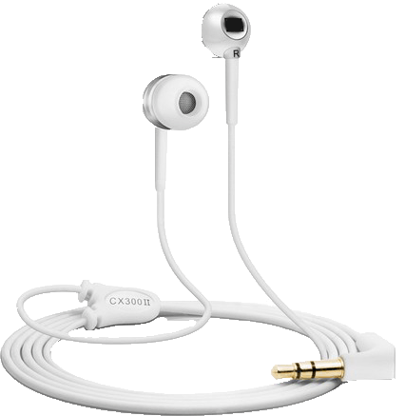
AIM
Integrated on earphones
On Android smart phones
Easy to use as earphone

Slide 4
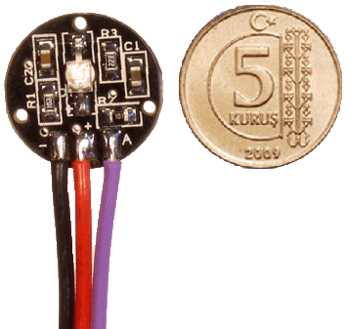
HOW IT WORKS?
Integrated heart rate sensor on earphone
Circuit contains only LED, phototransistor and amplifier

Slide 5
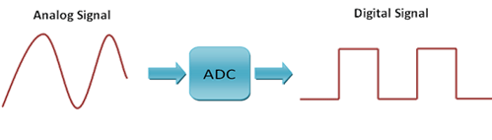
HOW IT WORKS?
Raw analog signals are transfered over microphone input of the smart phone
Let the Analog to Digital converter of smart phone do the conversion job
Now, smart phone processes digital signals to find heart rate and calorie consumption

Slide 6
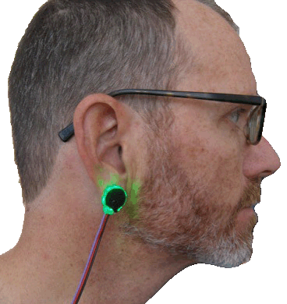
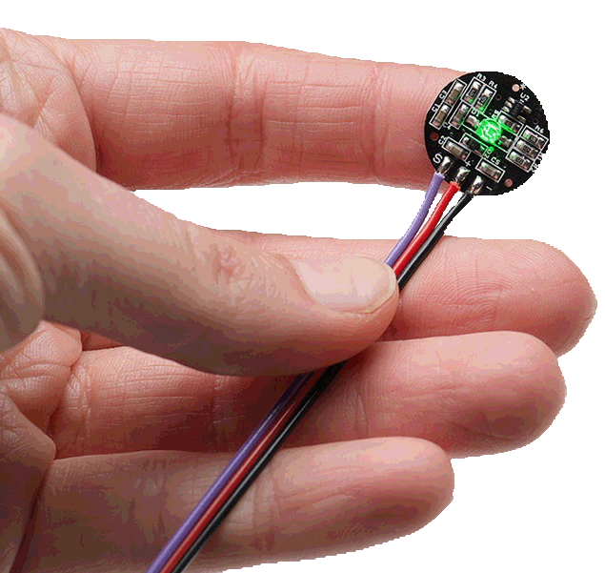
HOW TO USE?
Plug earphone to smart phone as usual
Wear earphone
Wear sensor circut on earlobe

Slide 7
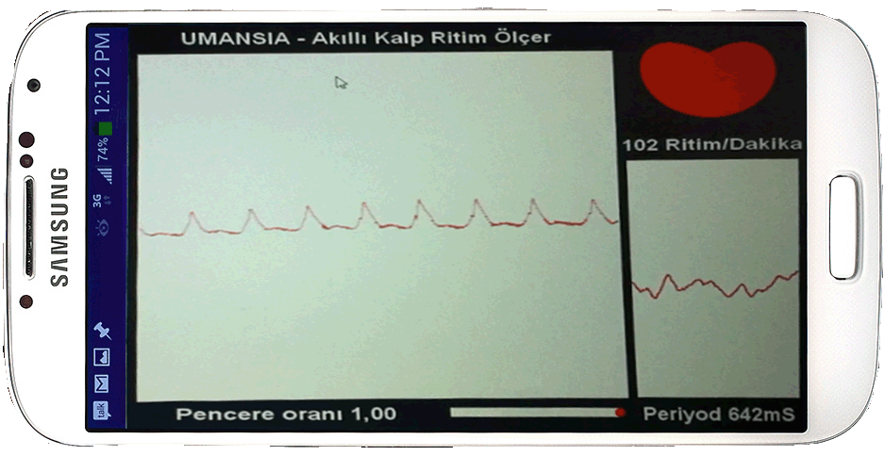
HOW TO USE?
Turn on smart phone application
Start monitoring heart rate
Start tracking your sportive activites and calorie consumption

Slide 8
WHY TO PREFER?
Easy to waer as earphone
No need to extra devices like wristband, necklace, chest band
No need to Bluetooth:
Cheap
Low power consumption
Requires only microphone input
No need to extra proccessor unit

Slide 9
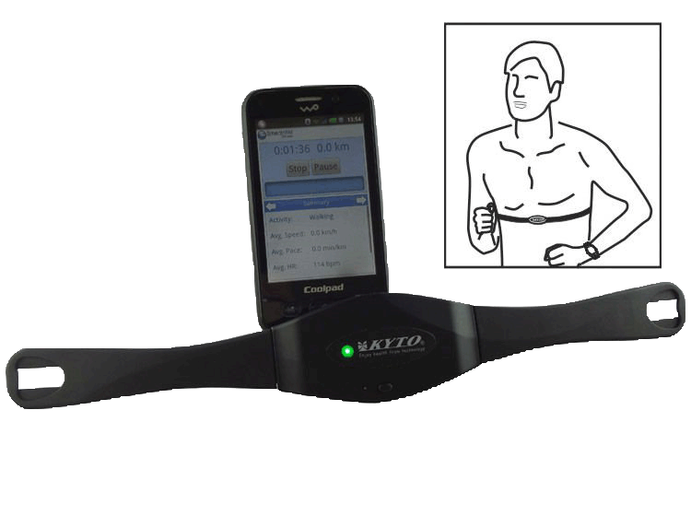
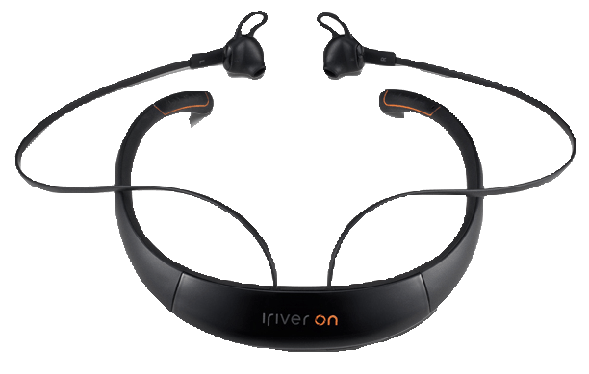
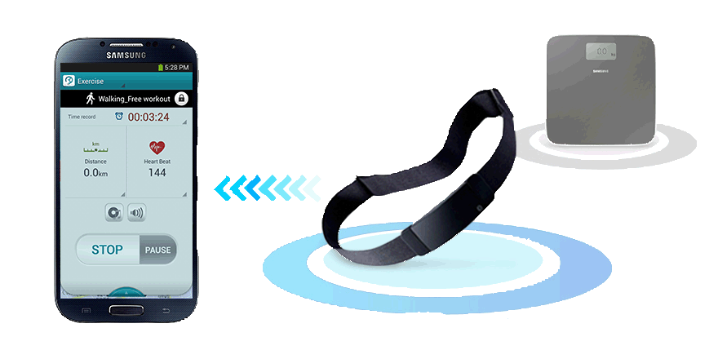
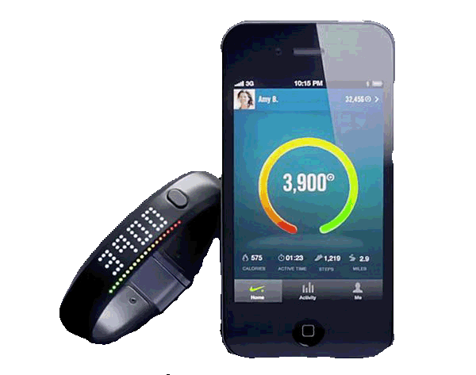
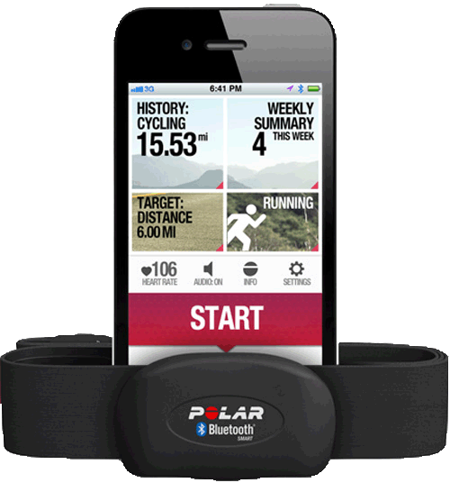
COMPETITORS
Lots of heart rate monitor gadgets on market
All of them use Bluetooth
Wrist, neck and chest; not ear
Expensive

Slide 10
THANK YOU FOR LISTENING TO US!

